Slide 1


This presentation has been created by Down syndrome UK, registered charity number 1184564
It is available for general use but would ask that if a school has a member(s) who has/have Down syndrome, or there are close relatives of a young person with Down syndrome,
that you seek permission of the Parents/Carers first.
We hope you find this presentation informative and insightful
We would welcome your feedback: info@downsyndromeuk.co.uk
Please note that this presentation contains links to YouTube
So please ensure you can access beforehand
There is an accompanying lesson plan

Slide 2
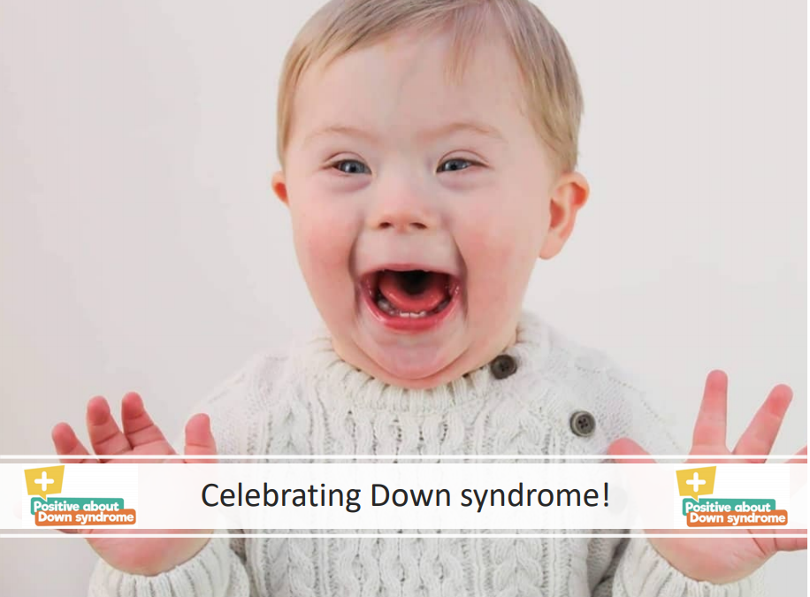
Lower KS2 Presentation
Celebrating Down syndrome!

Slide 3
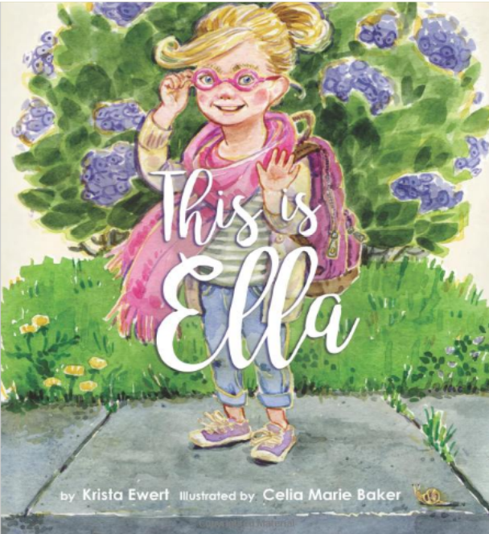

Slide 4
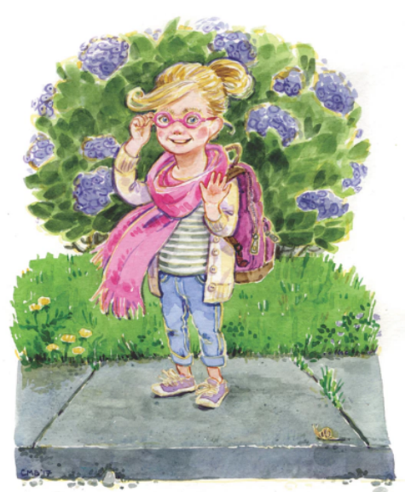
This is Ella.
Ella is seven years old and likes to go to school.
Every day she packs her lunch and puts on her backpack.
Do you like school?

Slide 5
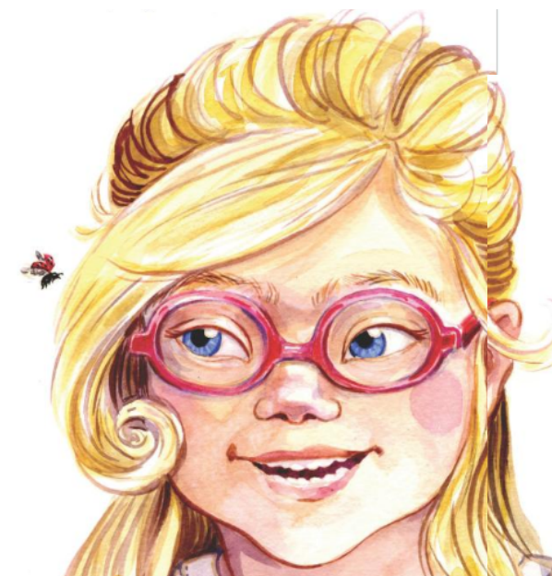
Ella has blond hair and blue eyes. She wears pink glasses.
Do you have blue eyes too?
Or do you have brown eyes?
Maybe your eyes are green.
Or purple.
Or maybe even aquamarine.

Slide 6
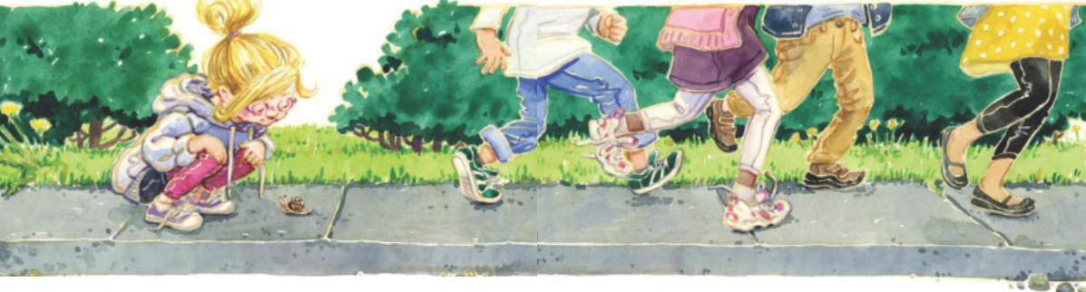
Ella is small. She might be smaller than you.
And she might not run as fast as you.
But she still wants to be included… just like you.

Slide 7
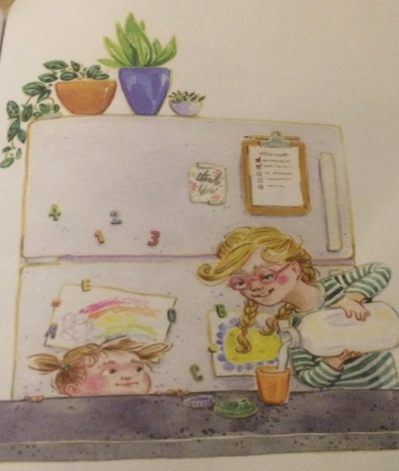
Ella can count to ten and knows all of her letters.
She can set the table and help her baby sister get a drink of milk.
What do you help with at home?

Slide 8
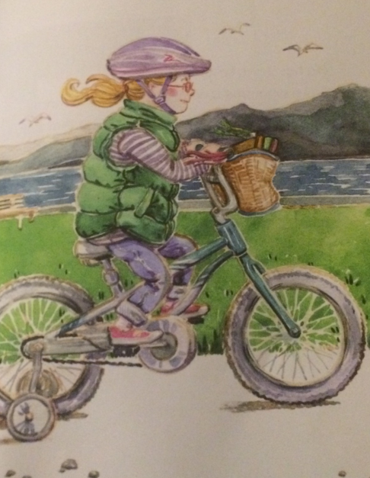
Ella loves to dance and ride her bike.
Ella’s bike is blue with a basket on the front.
Do you have a bike?
What colour is it?

Slide 9
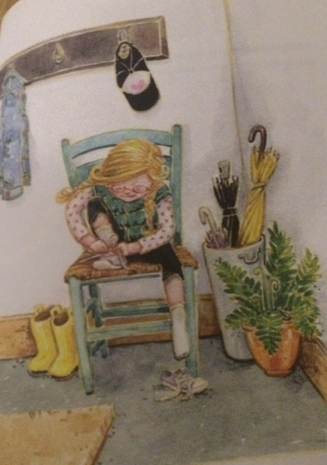
Ella has Down syndrome.
Down Syndrome is not a disease. You cannot catch Down Syndrome; it is something Ella was born with.
Ella wants to be treated with respect.
Sometimes Ella needs help and sometimes she likes to do things by herself… just like you.

Slide 10
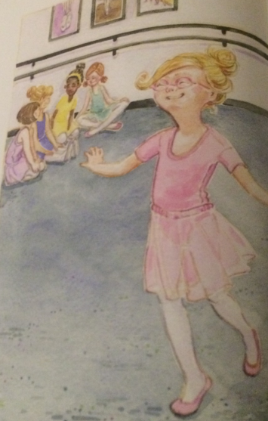
Ella has a hard time saying some words.
She has to practise some words just like she has to practise sitting still.
Do you have to practise sitting still?

Slide 11
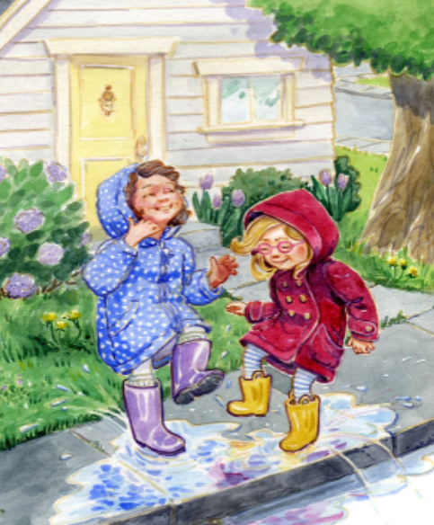
Ella can be a good friend.
She can play games and run and jump and climb.
She can share and sometimes she can be very, very silly.
Do you like to be silly?

Slide 12
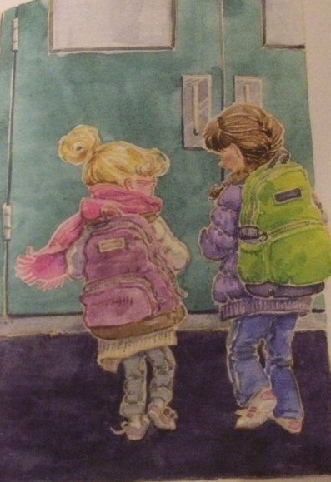
Ella likes to learn and play but most of all, Ella loves to be with her friends.
What do you think it means to be a good friend?

Slide 13
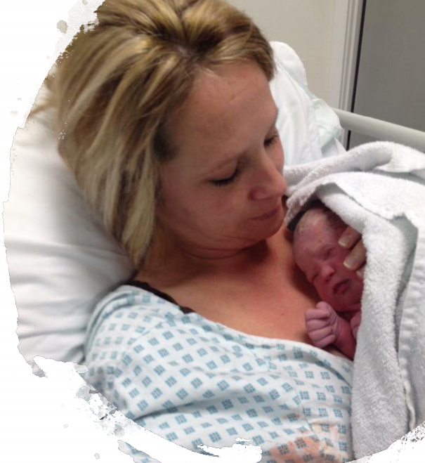
What is Down syndrome?
Babies are born with Down syndrome and will always have it.

Slide 14
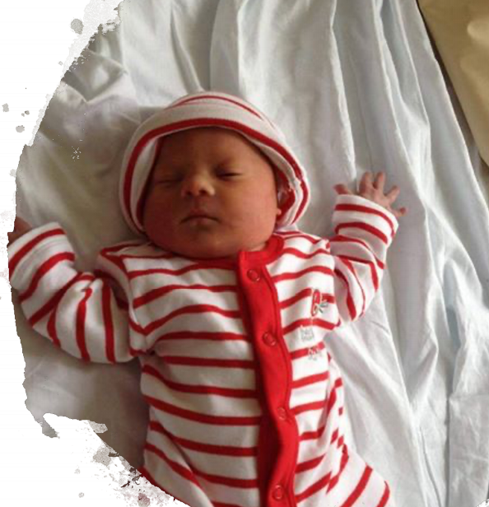
Down syndrome is not an illness.
You cannot catch it like a cold.

Slide 15
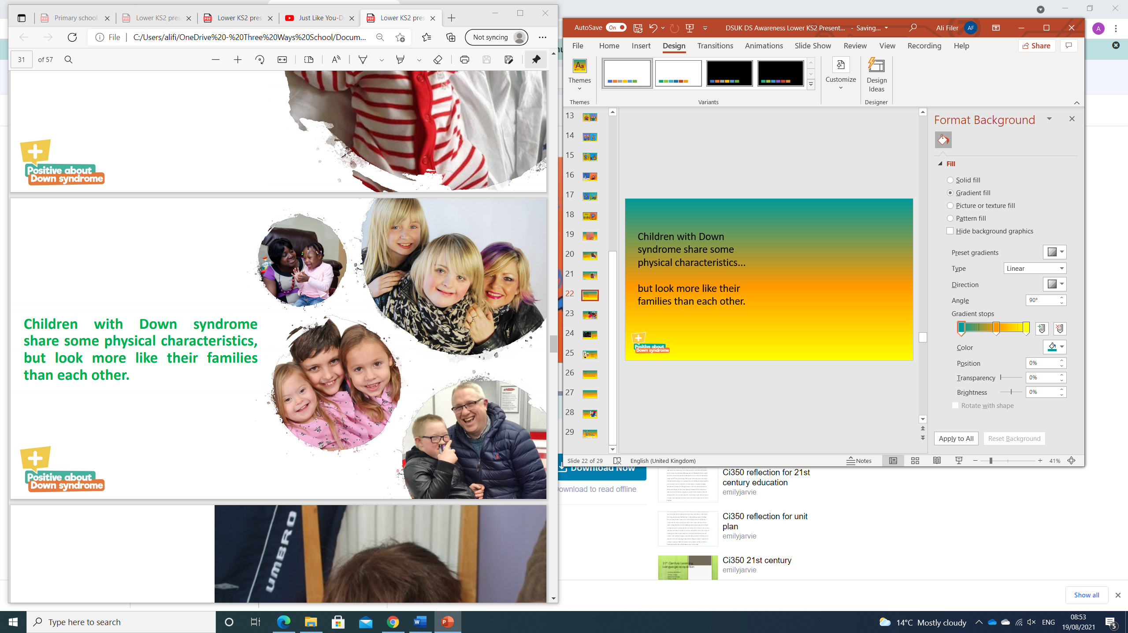
Children with Down syndrome share some physical characteristics...
but look more like their families than each other.

Slide 16
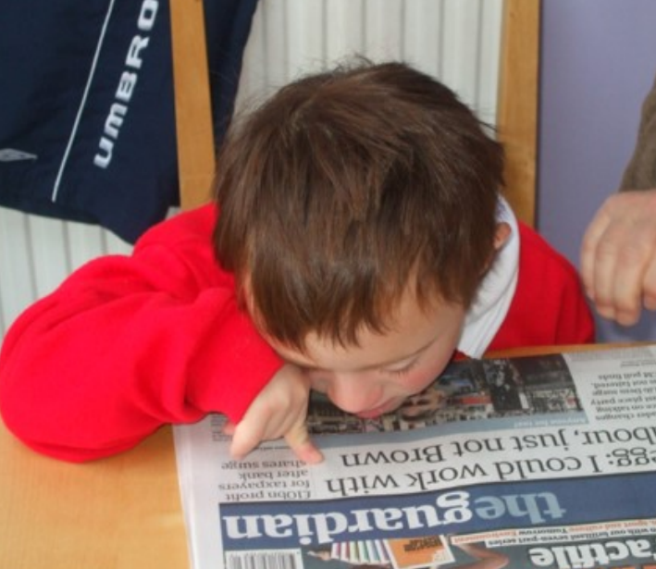
It may take children with Down syndrome longer to learn some things.
Having Down syndrome can affect their speech, learning and physical development.

Slide 17
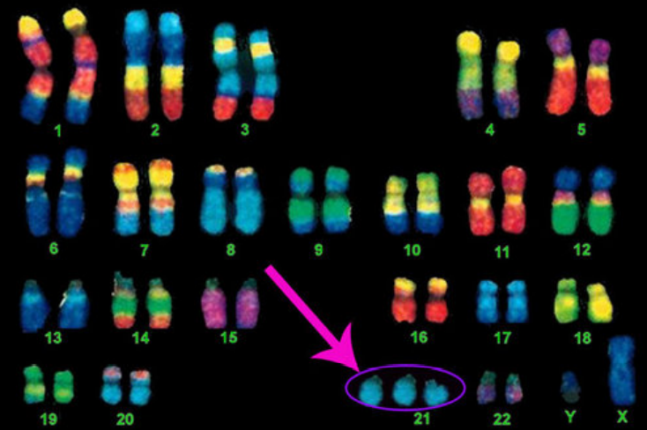
Down syndrome is caused by an extra chromosome in your cells
Chromosomes come in pairs - we get half from our mum and half from our dad
People without Down Syndrome have 46 chromosomes (23 pairs)
People with Down Syndrome have 47 chromosomes with a 3rd copy of 21st Chromosome

Slide 18
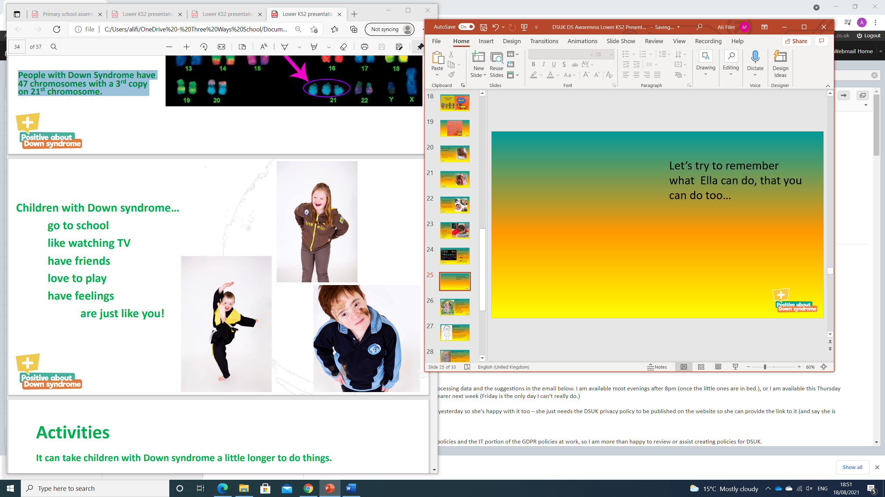
Children with Down syndrome…
go to school
like watching TV
have friends
love to play
have feelings
and are just like you!

Slide 19
Activities
It can take children with Down syndrome a little longer to do things.
Children with Down syndrome find speech difficult.
Children with Down syndrome can find writing tricky.

Slide 20
Just Like You-Down Syndrome - YouTube

Slide 21
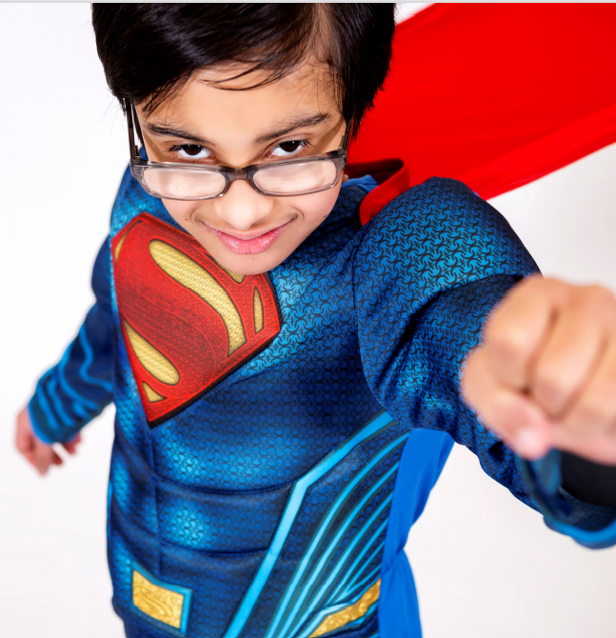
True or False?
Children with Down syndrome can’t go to school?

Slide 22
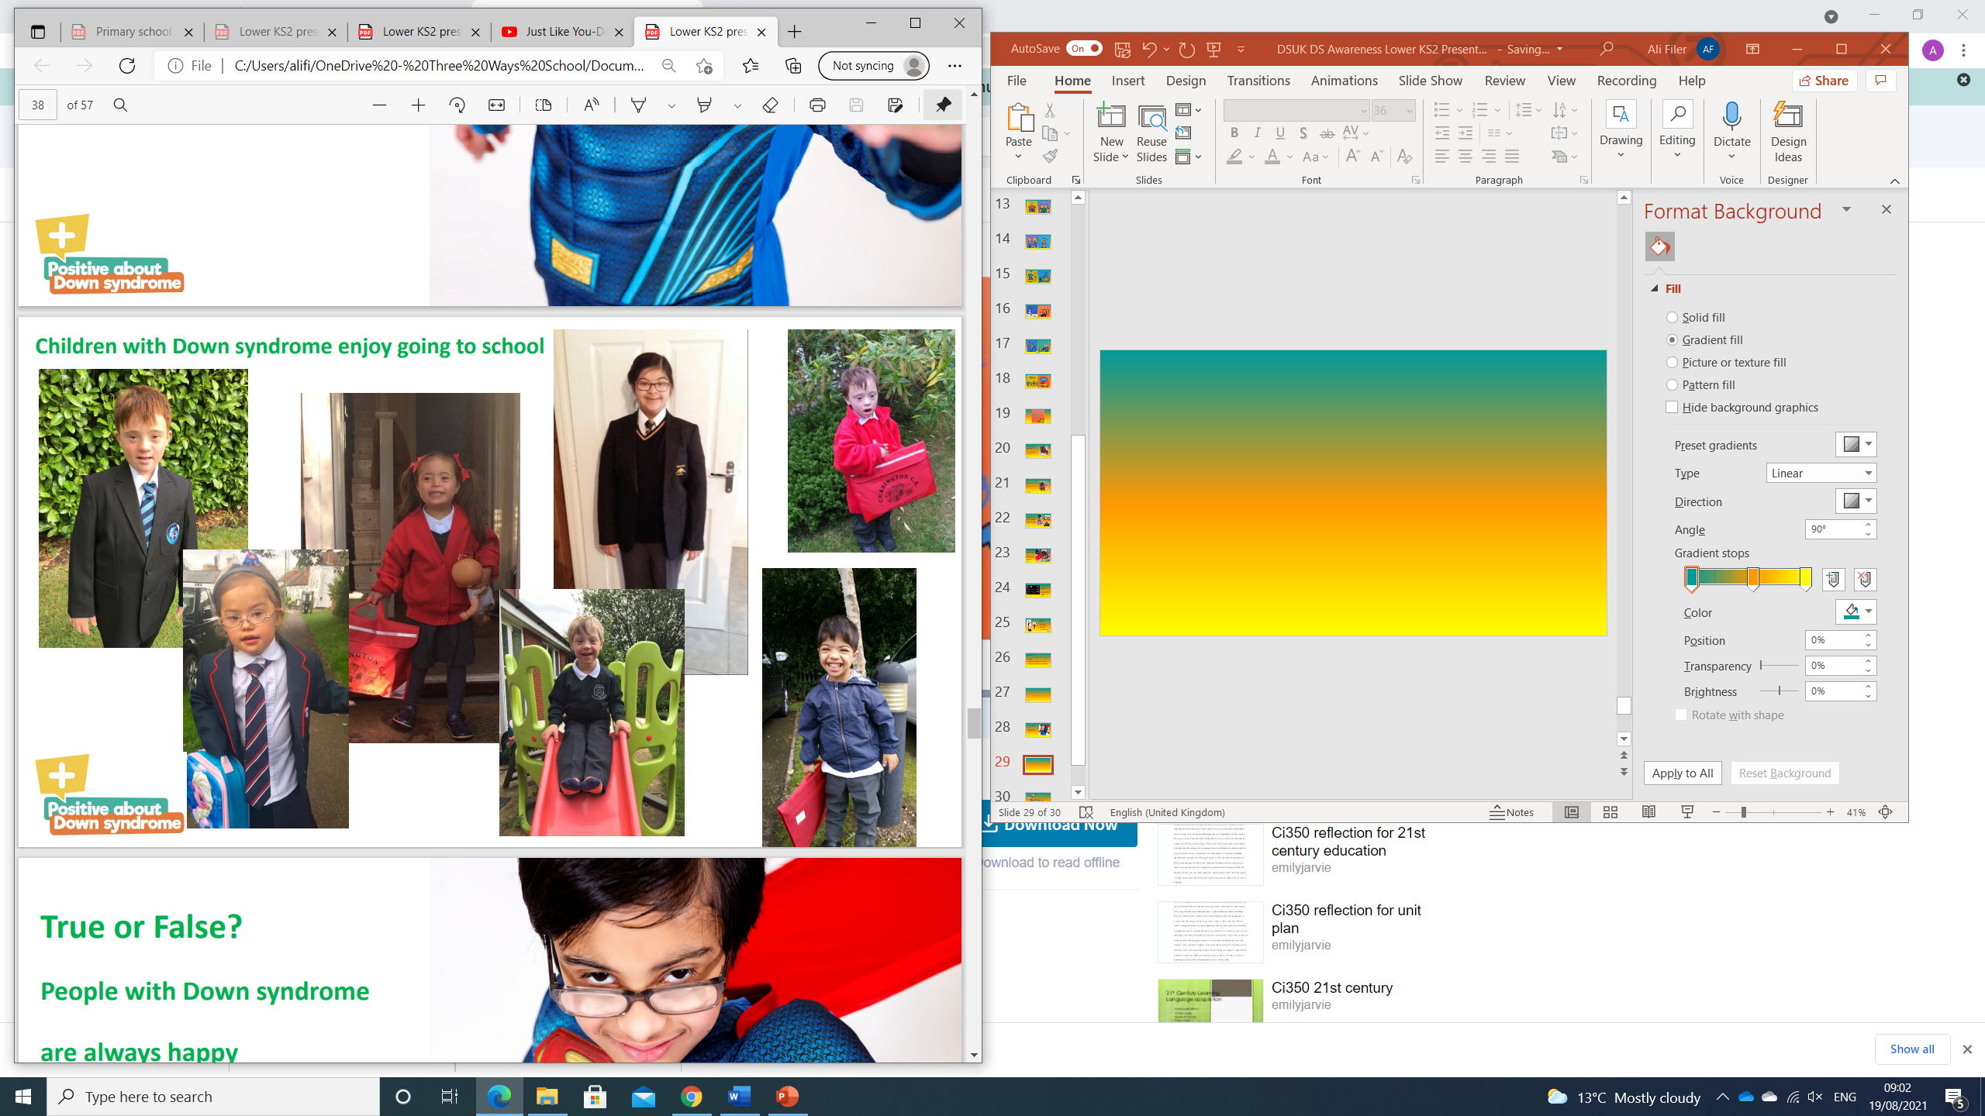
Children with Down syndrome enjoy going to school!

Slide 23
True or False?
People with Down syndrome are always happy?

Slide 24
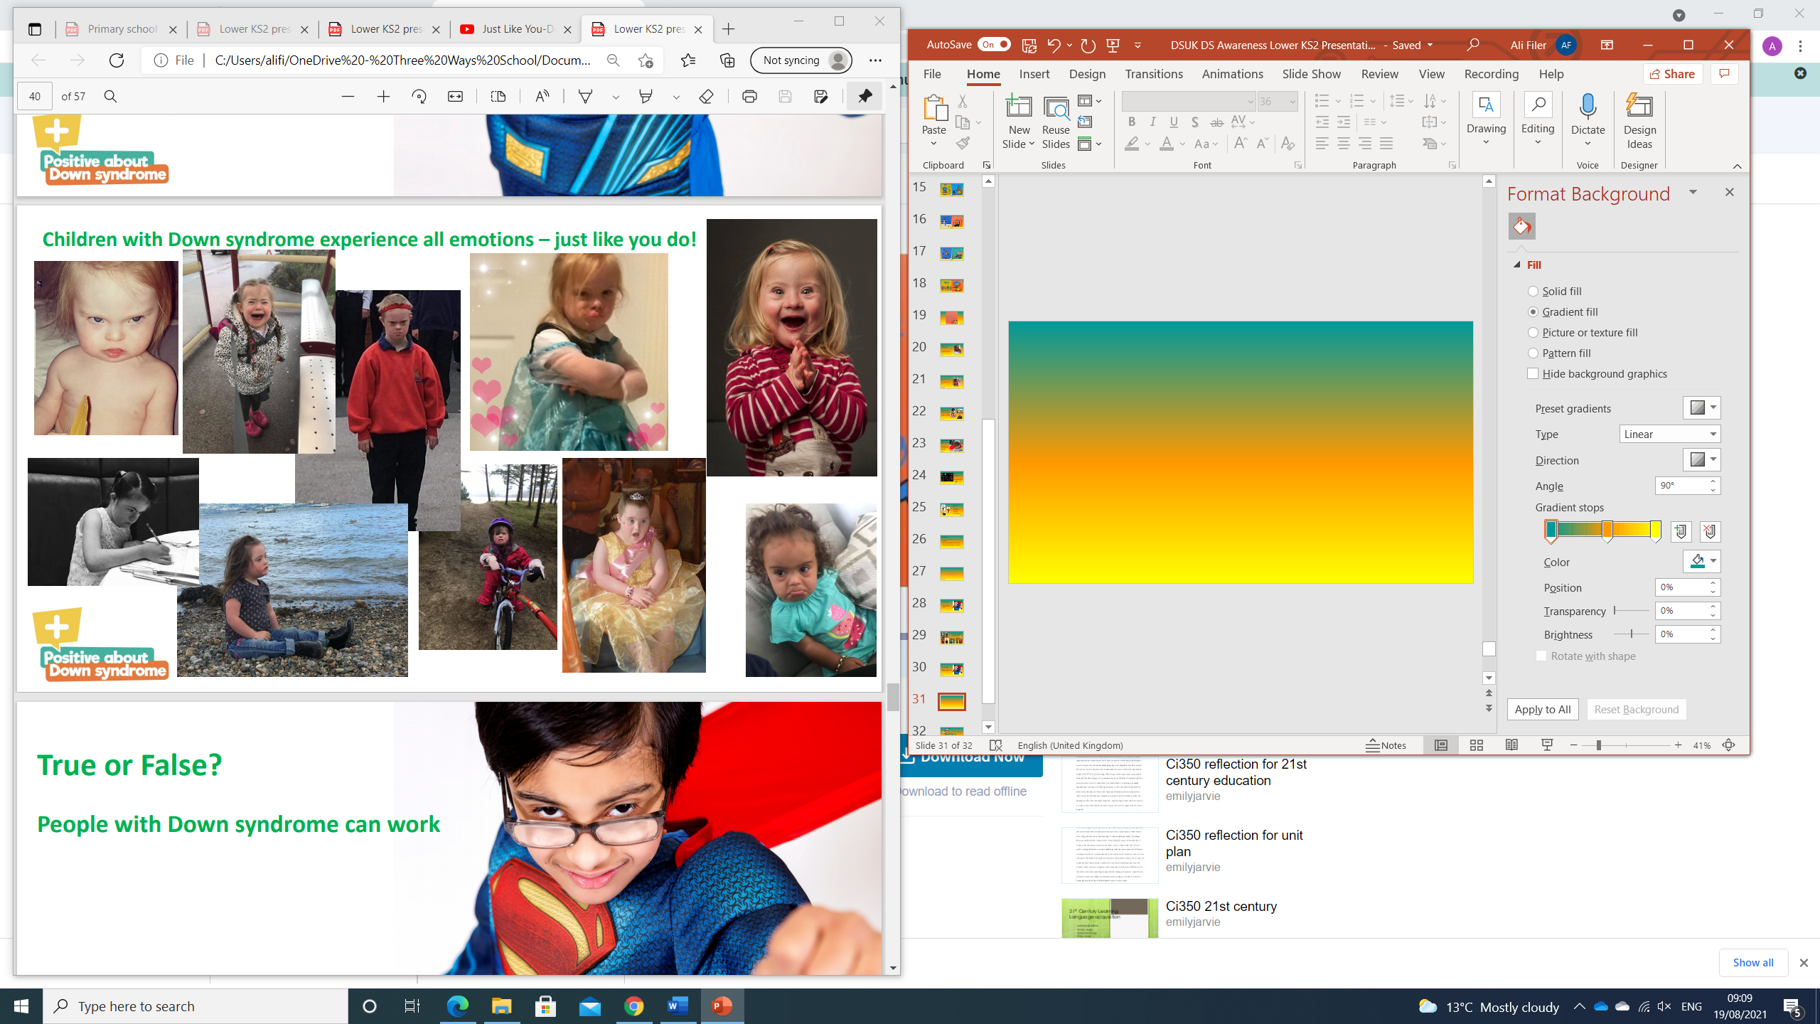
Children with
Down syndrome experience all emotions
just like you do!

Slide 25
True or False?
People with Down syndrome can get a job?

Slide 26
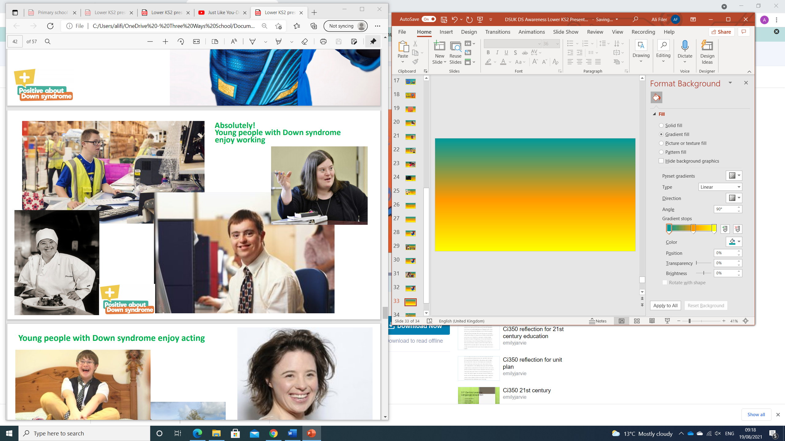
Absolutely!
Young people with Down syndrome enjoy working!

Slide 27
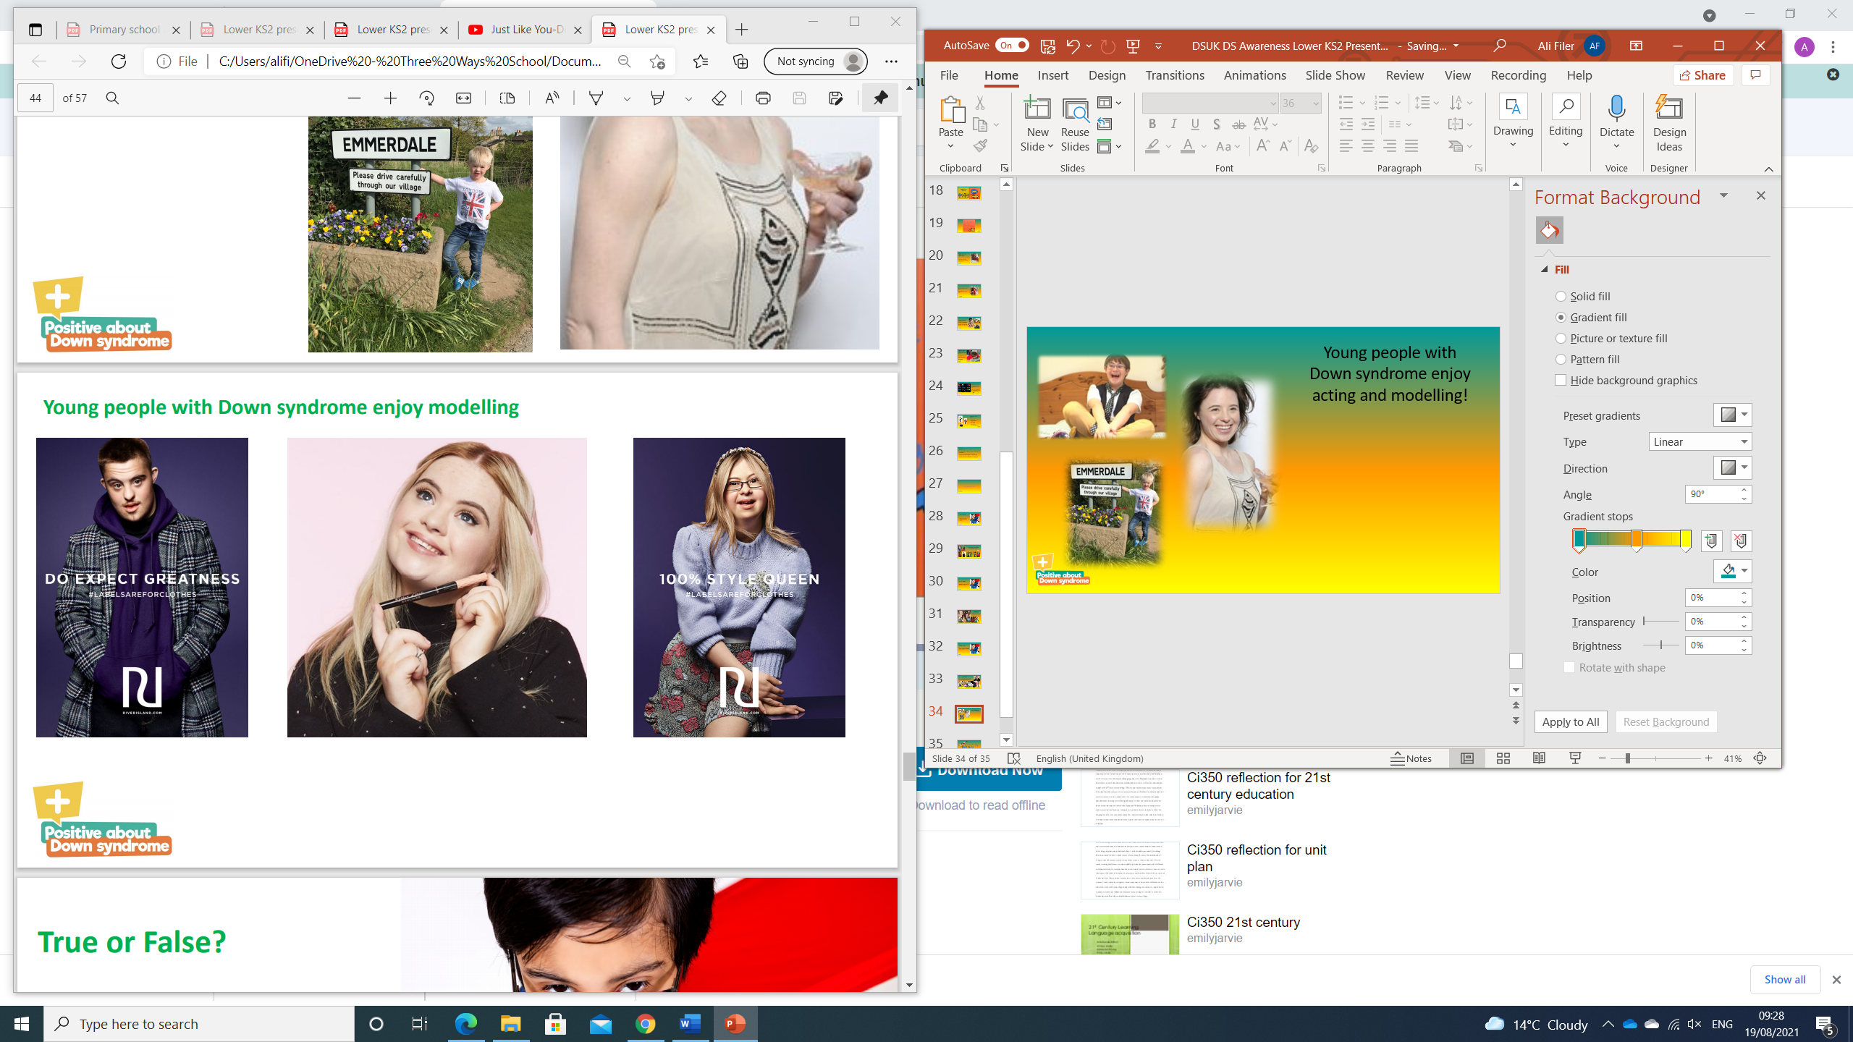
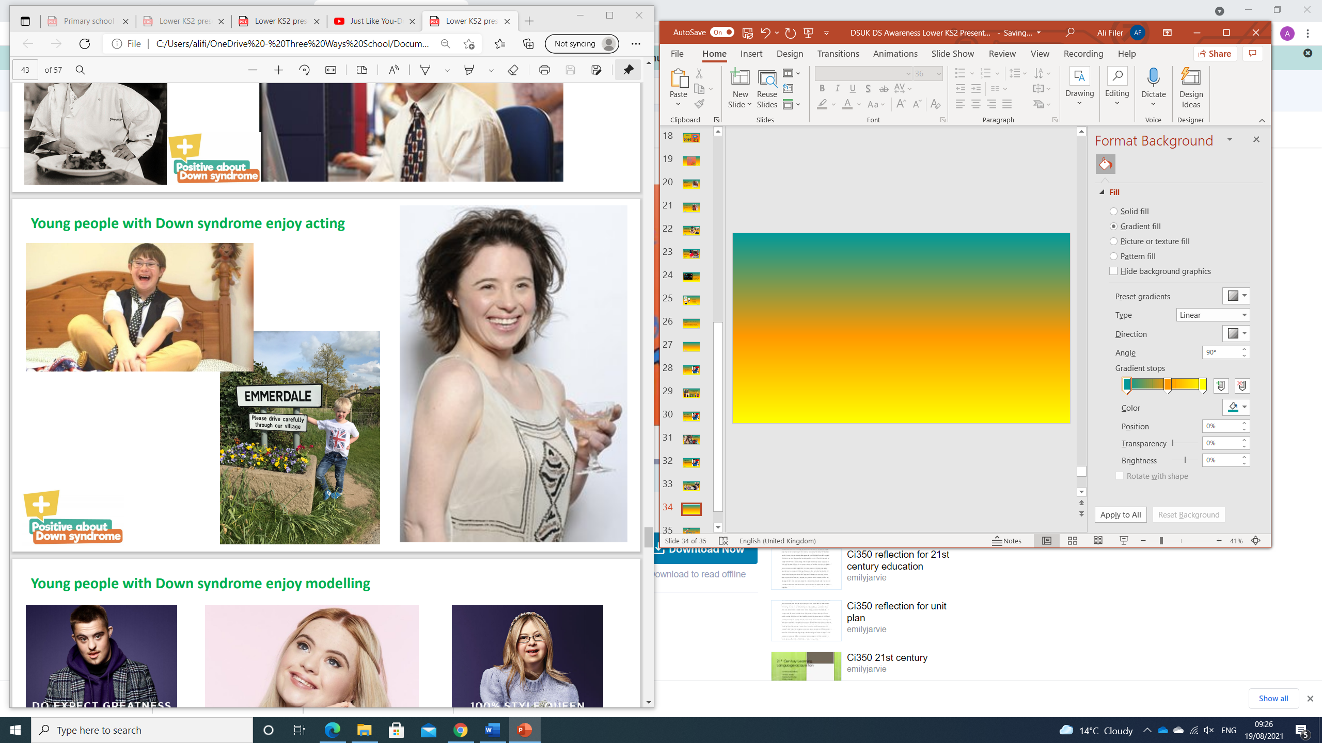
Young people with Down syndrome enjoy acting and modelling!

Slide 28
True or False?
You can catch
Down syndrome?

Slide 29
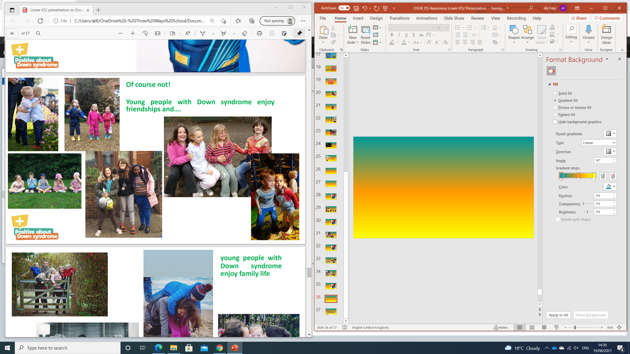
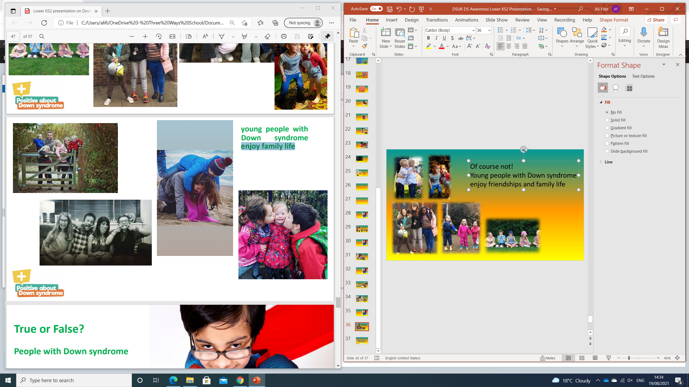
Of course not!
Young people with Down syndrome enjoy friendships and family life

Slide 30
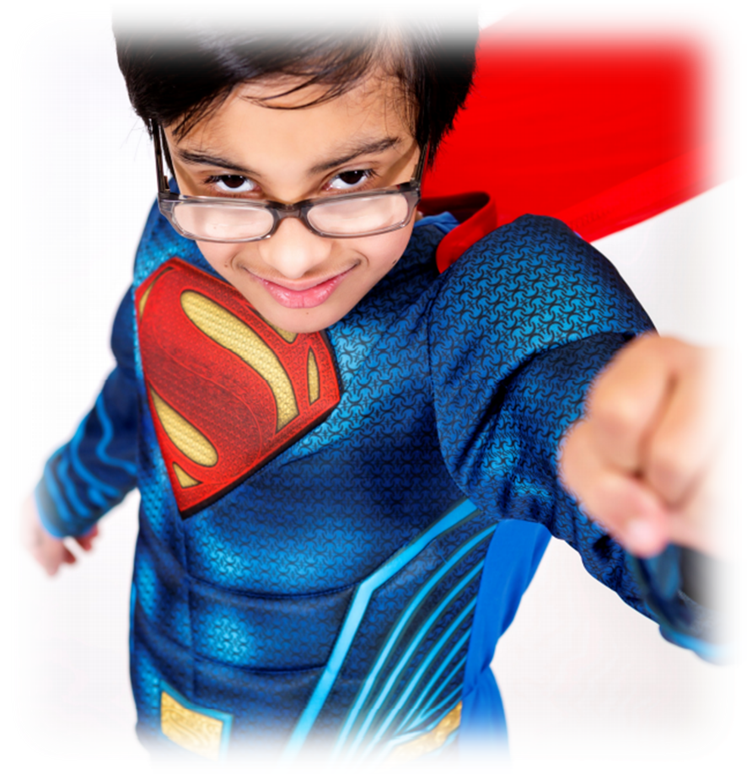
True or False?
People with Down syndrome can’t get married

Slide 31
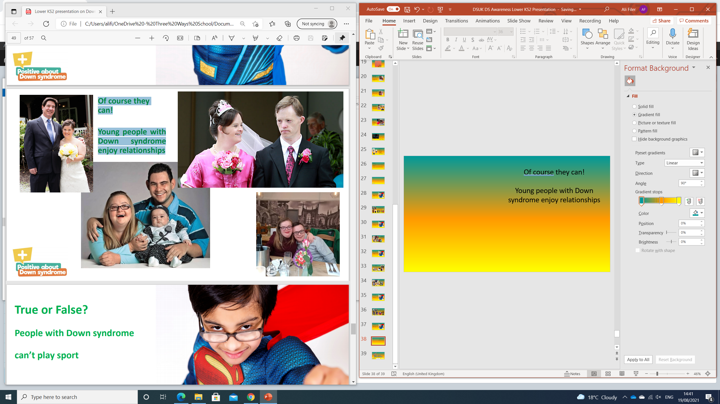
Of course they can!
Young people with Down syndrome enjoy relationships

Slide 32
True or False?
People with Down syndrome can’t play sport?

Slide 33
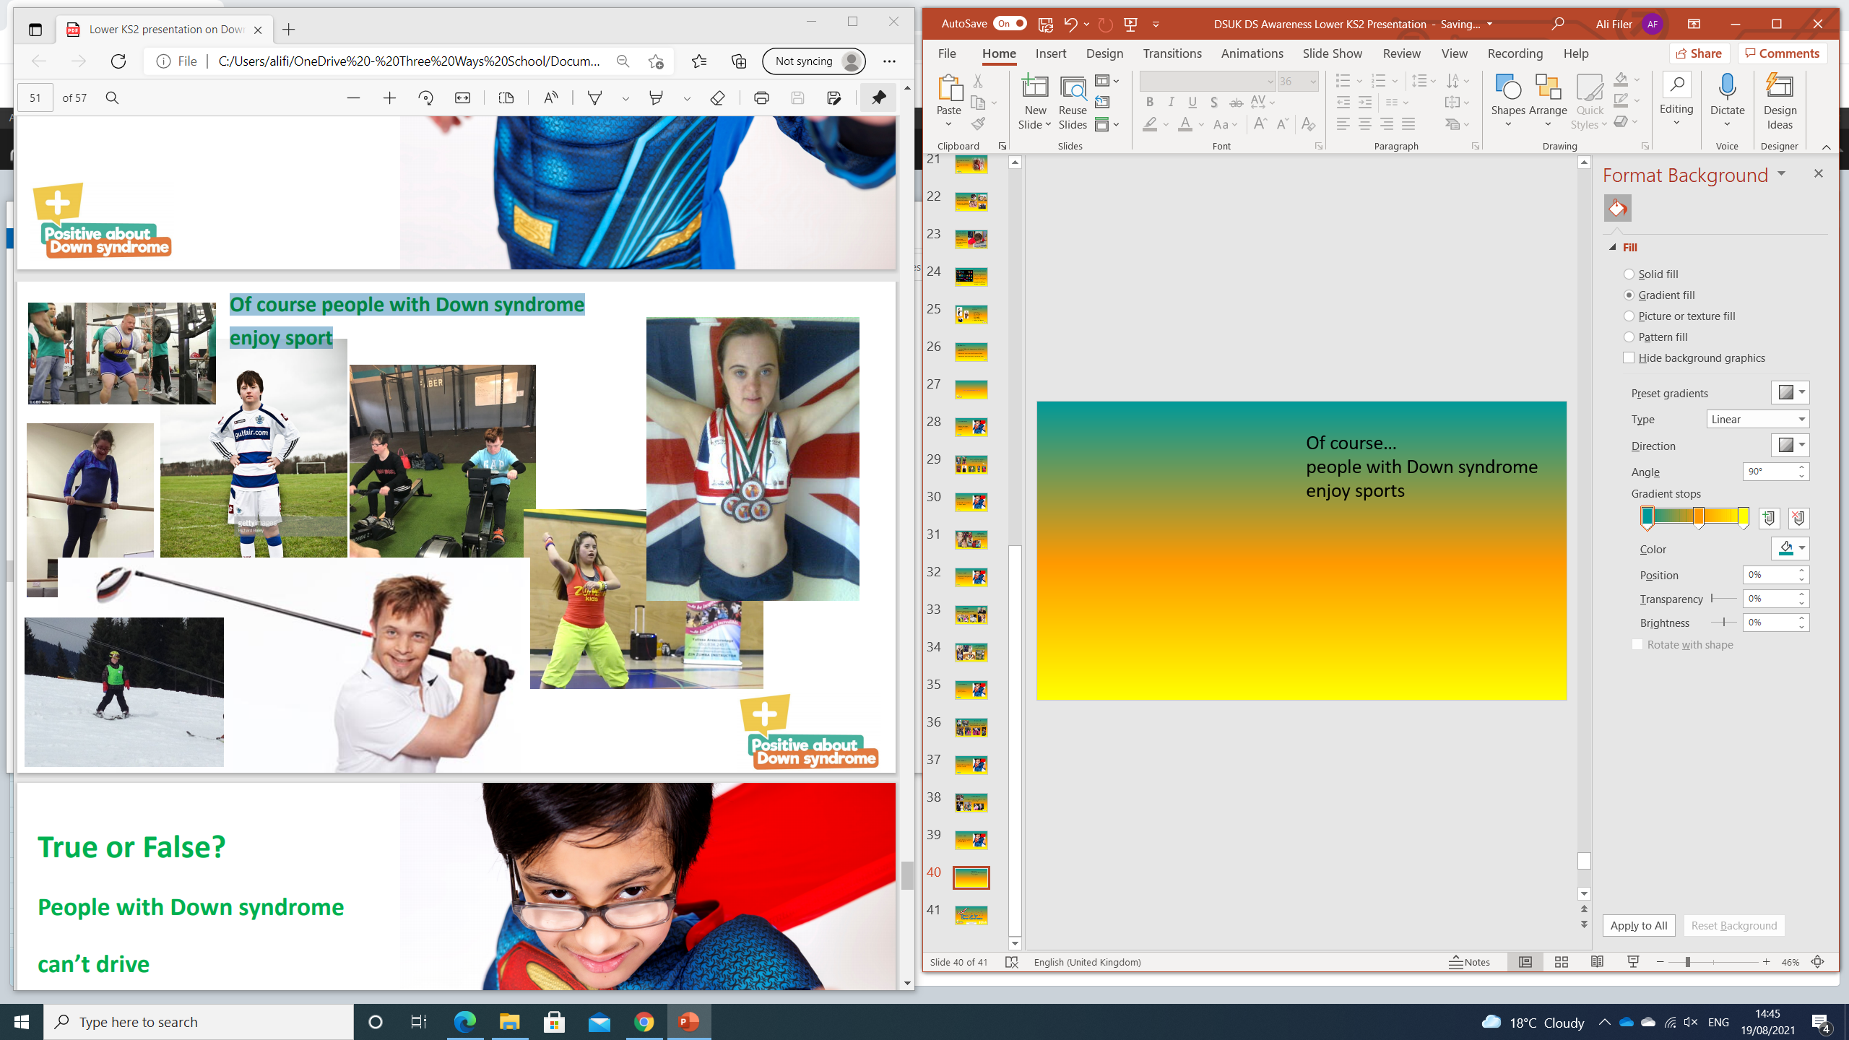
Of course…
people with Down syndrome enjoy sports

Slide 34
True or False?
People with Down syndrome can’t drive?

Slide 35
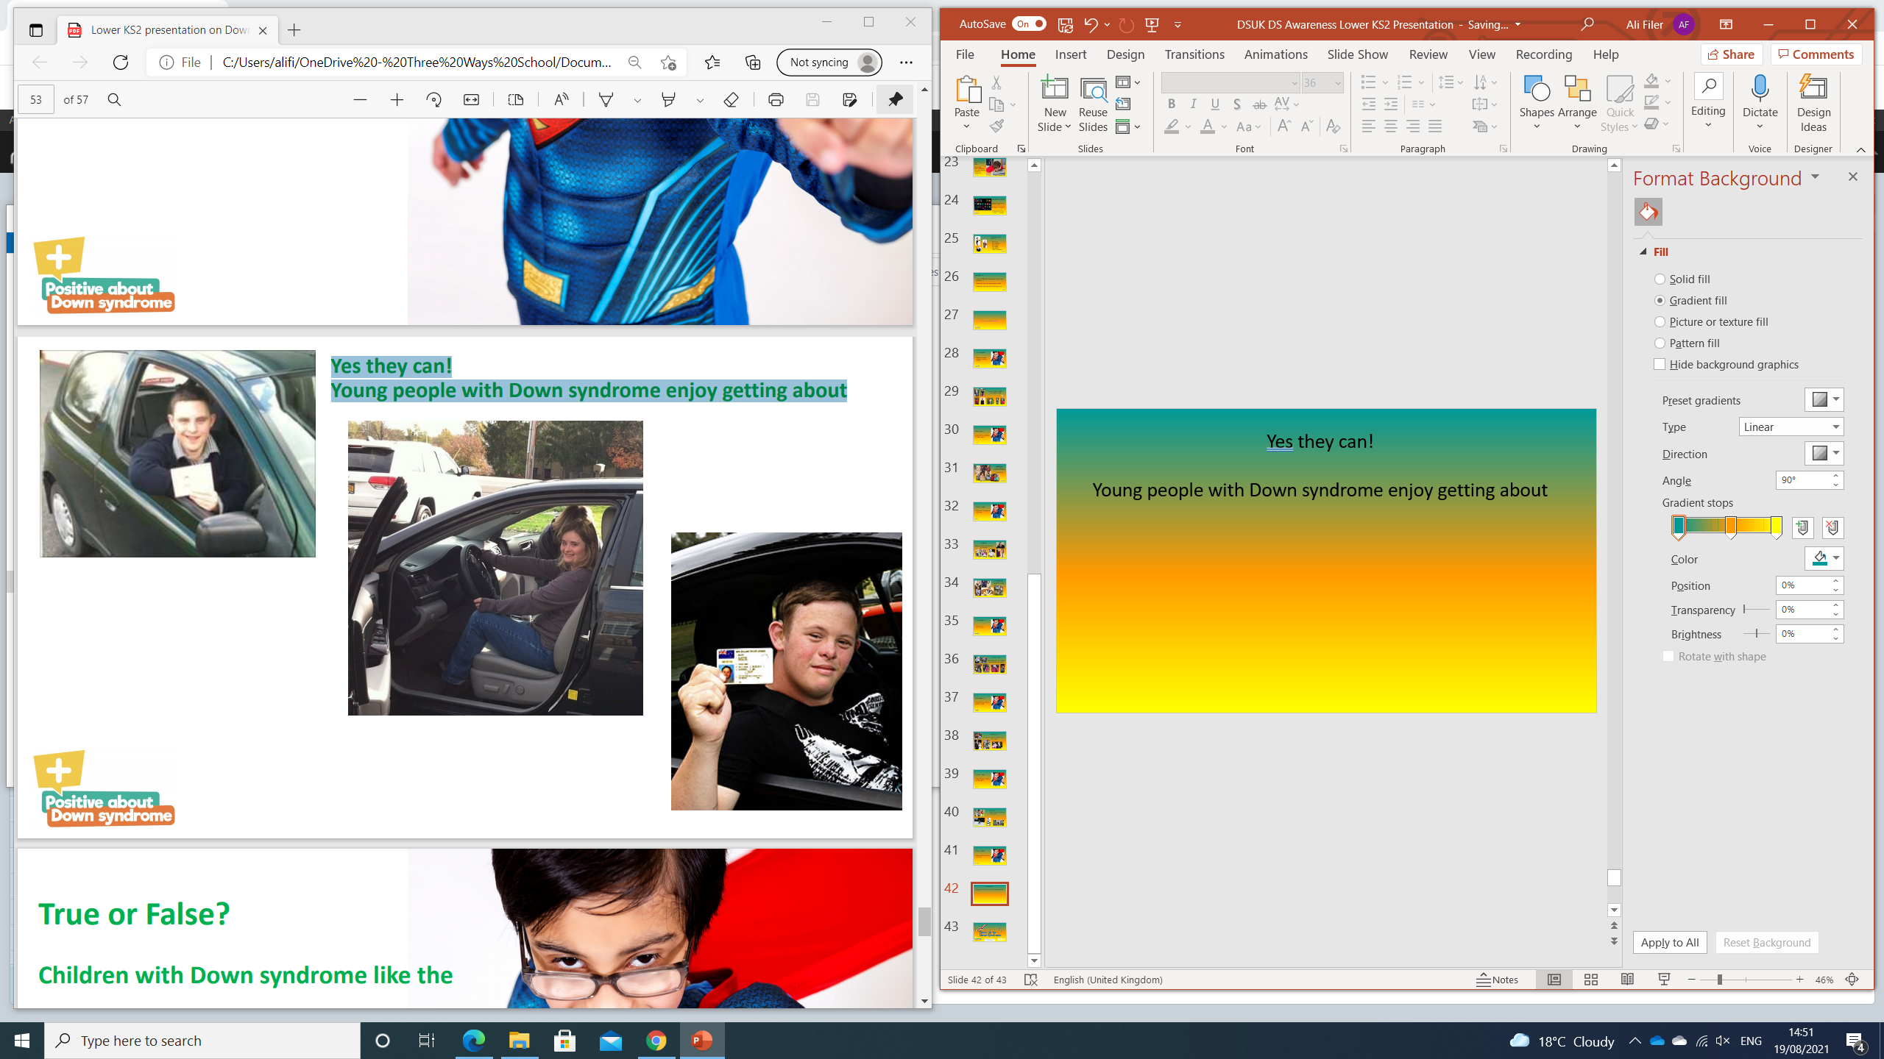
Yes they can!
Young people with Down syndrome enjoy getting about

Slide 36
True or False?
Children with Down syndrome like the same things as other children?

Slide 37
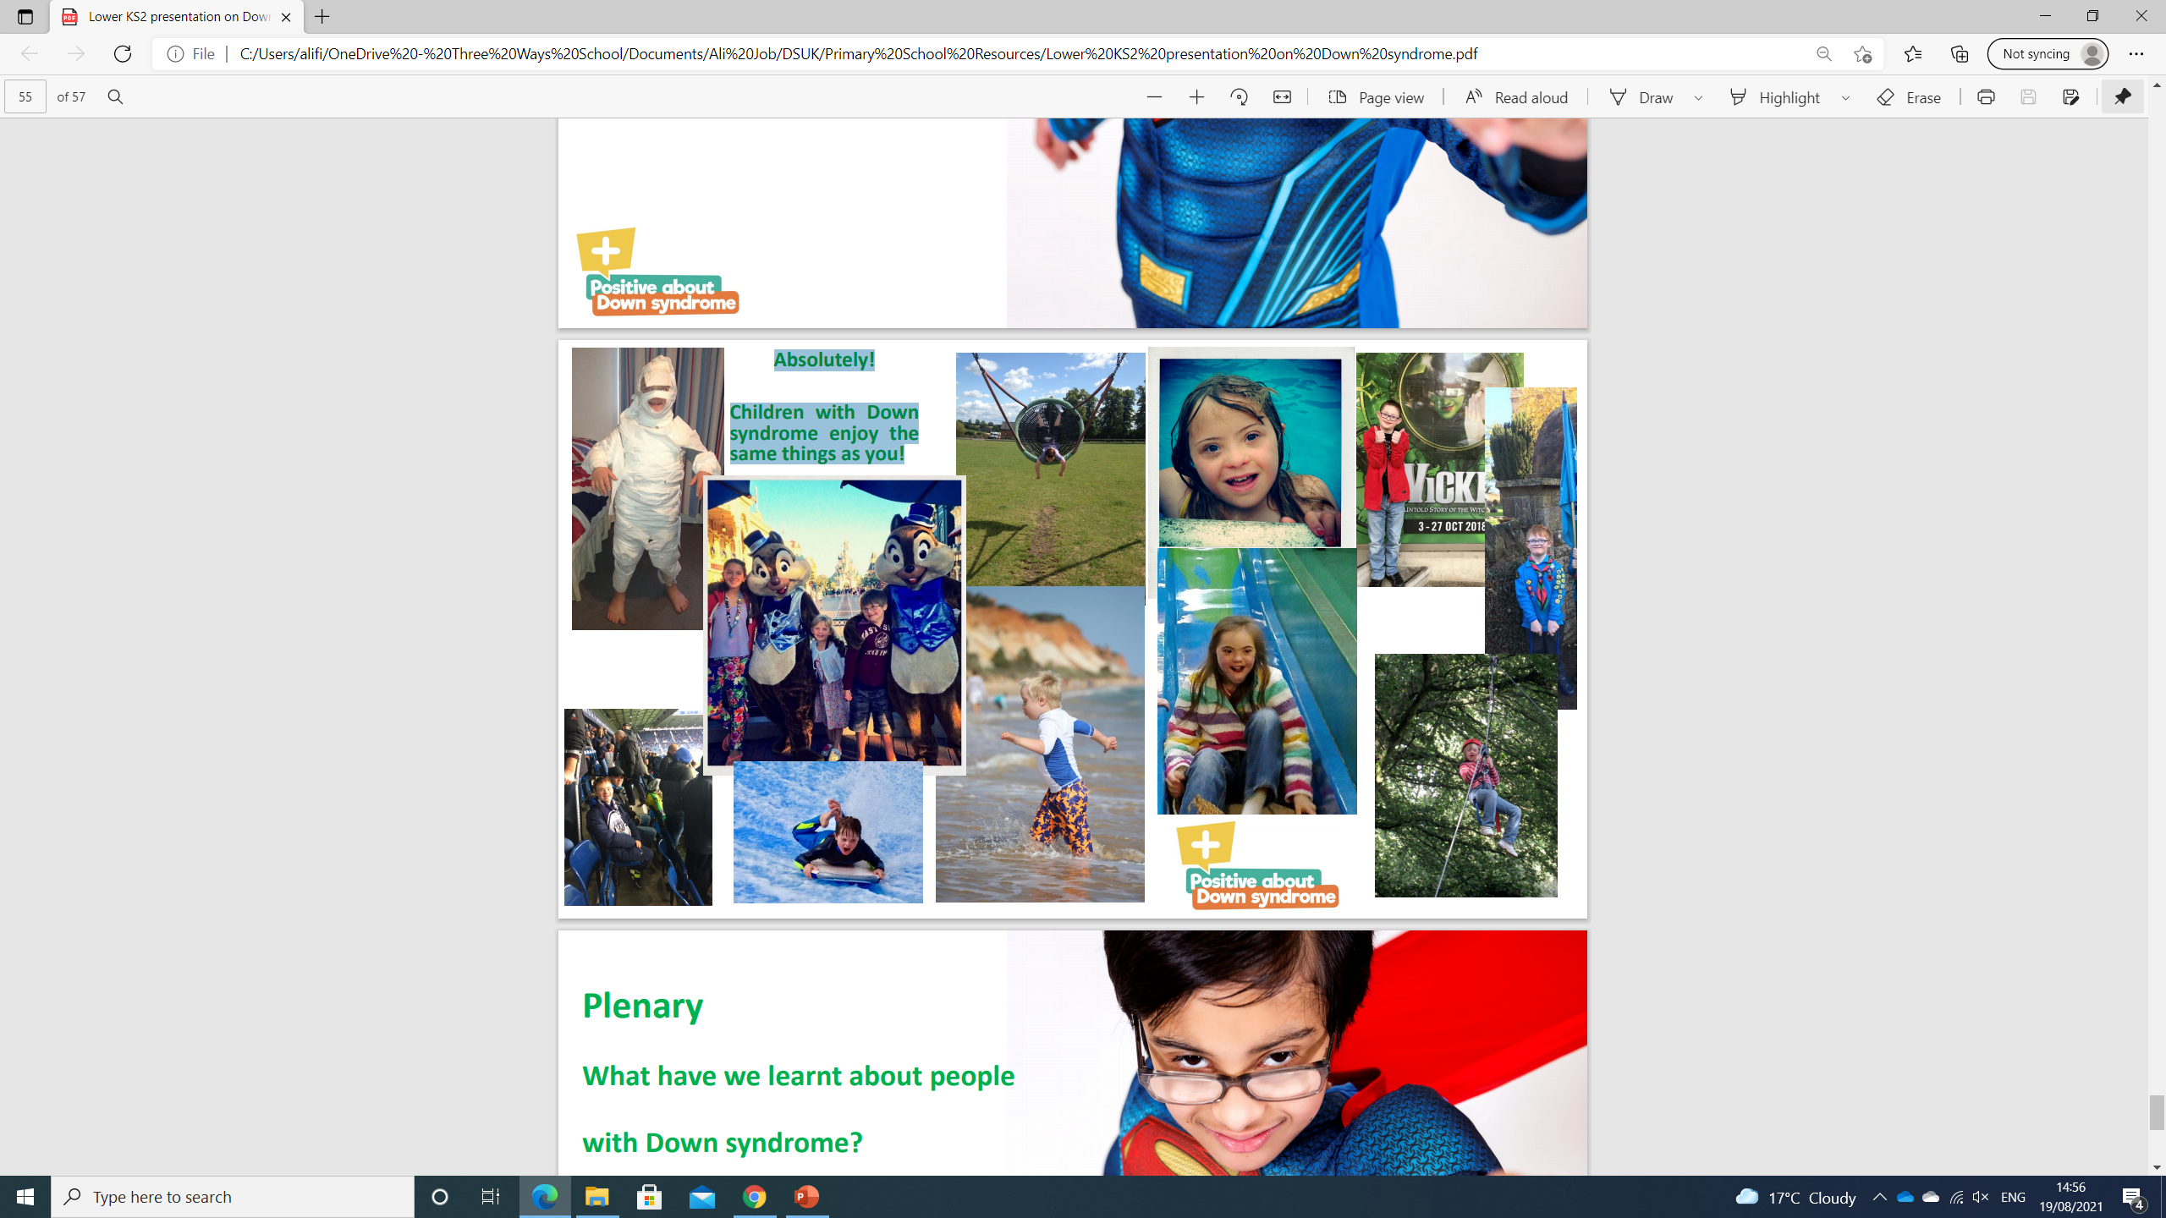
Absolutely!
Children with Down syndrome enjoy the same things as you!

Slide 38
What have we learnt about people with Down syndrome?

Slide 39
© 2021 Positive about Down Syndrome | A DSUK initiative
All rights reserved | Registered Charity Number 1184564

