Slide 1


This presentation has been created by DSUK, registered charity number 1184564
It is available for general use but would ask that if a school has a member(s) who has/have Down syndrome, or there are close relatives of a young person with Down syndrome,
that you seek permission of the Parents/Carers first.
We hope you find this presentation informative and insightful
We would welcome your feedback: info@downsyndromeuk.co.uk
Please note that this presentation contains links to YouTube
So please ensure you can access beforehand
There is an accompanying lesson plan

Slide 2
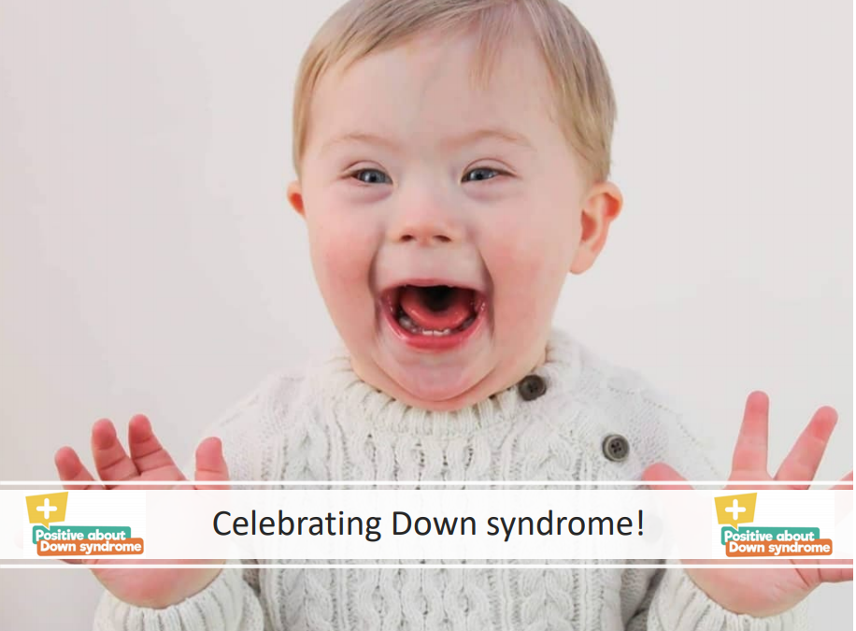
KS1 Presentation
Celebrating Down syndrome!

Slide 3
We are the same and we are different
Sesame Street: Same and Different with Elmo and Abby - YouTube
Me
My friend

Slide 4
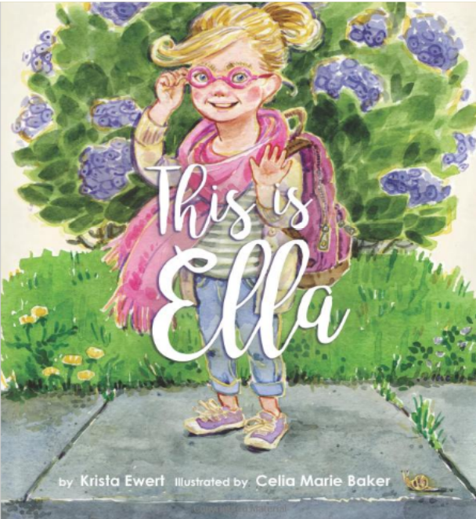

Slide 5
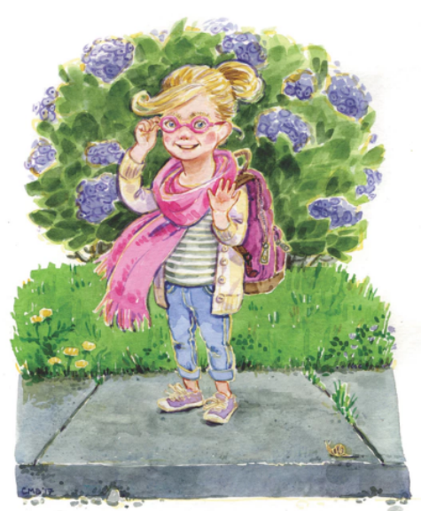
This is Ella.
Ella is seven years old and likes to go to school.
Every day she packs her lunch and puts on her backpack.
Do you like school?

Slide 6
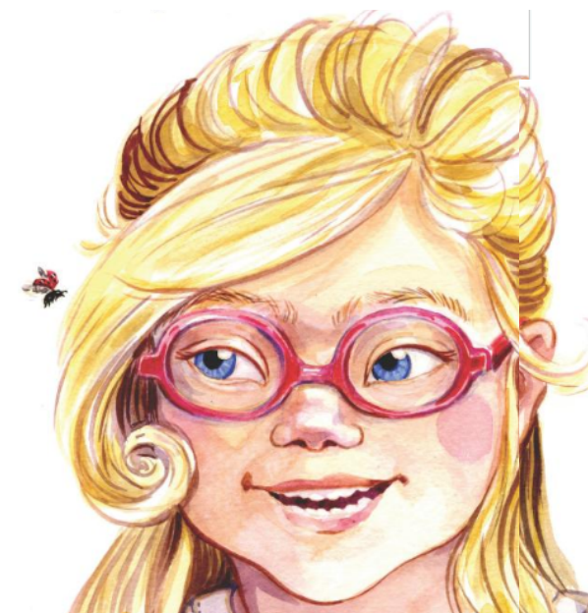
Ella has blond hair and blue eyes. She wears pink glasses.
Do you have blue eyes too?
Or do you have brown eyes?
Maybe your eyes are green.
Or purple.
Or maybe even aquamarine.

Slide 7
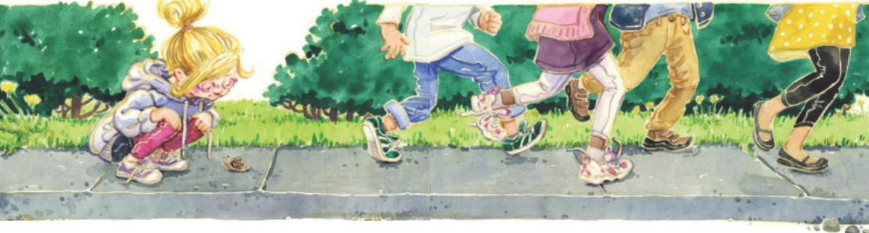
Ella is small. She might be smaller than you.
And she might not run as fast as you.
But she still wants to be included… just like you.

Slide 8
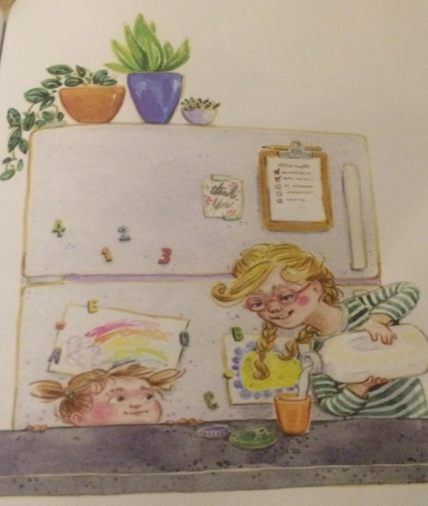
Ella can count to ten and knows all of her letters.
She can set the table and help her baby sister get a drink of milk.
What do you help with at home?

Slide 9
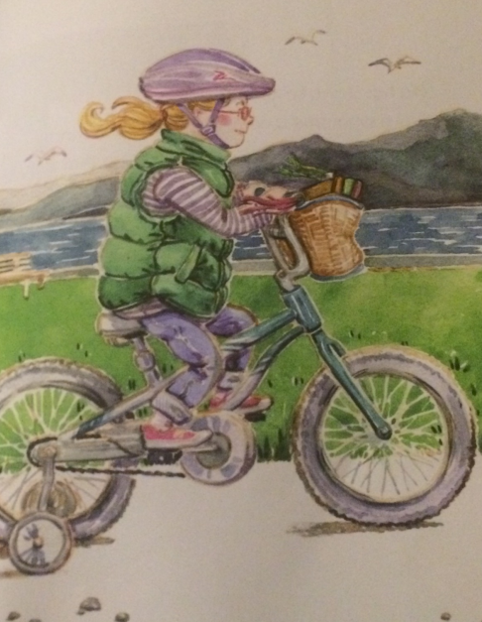
Ella loves to dance and ride her bike.
Ella’s bike is blue with a basket on the front.
Do you have a bike?
What colour is it?

Slide 10
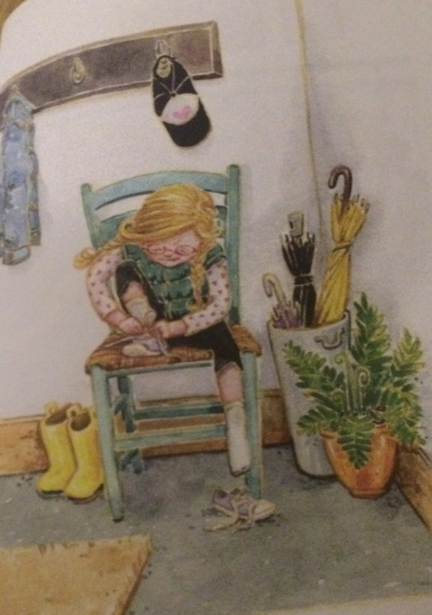
Ella has Down syndrome.
Down Syndrome is not a disease. You cannot catch Down Syndrome; it is something Ella was born with.
Ella wants to be treated with respect.
Sometimes Ella needs help and sometimes she likes to do things by herself… just like you.

Slide 11
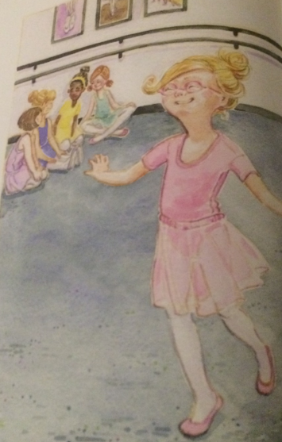
Ella has a hard time saying some words.
She has to practise some words just like she has to practise sitting still.
Do you have to practise sitting still?

Slide 12
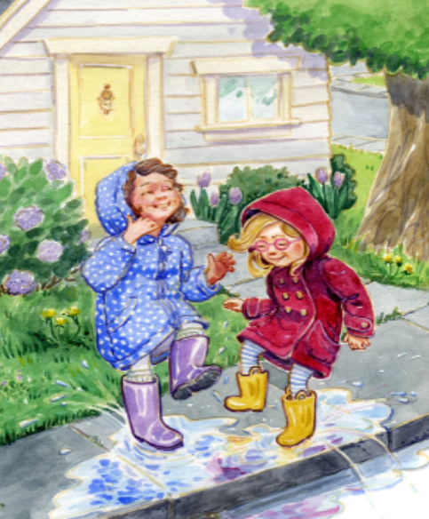
Ella can be a good friend.
She can play games and run and jump and climb.
She can share and sometimes she can be very, very silly.
Do you like to be silly?

Slide 13
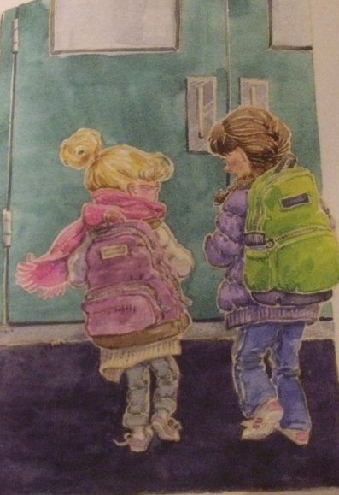
Ella likes to learn and play but most of all, Ella loves to be with her friends.
What do you think it means to be a good friend?

Slide 14
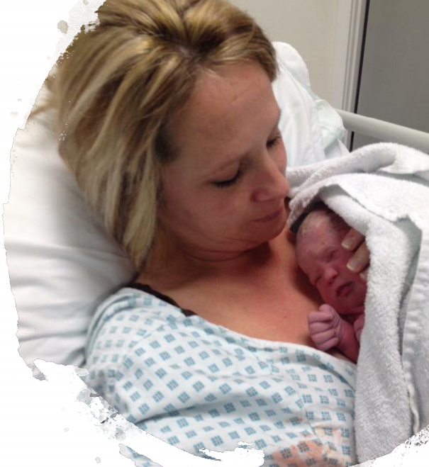
Ella has Down syndrome.
What is Down syndrome?
Babies are born with Down syndrome and will always have it.

Slide 15
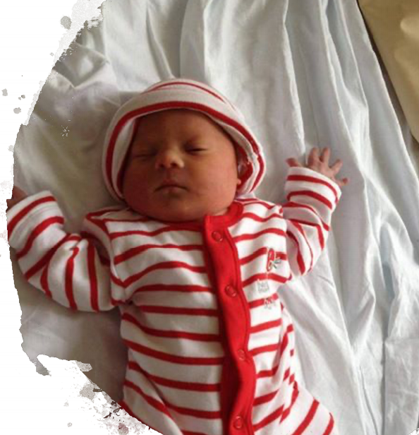
Down syndrome is not an illness.
You cannot catch it like a cold.

Slide 16
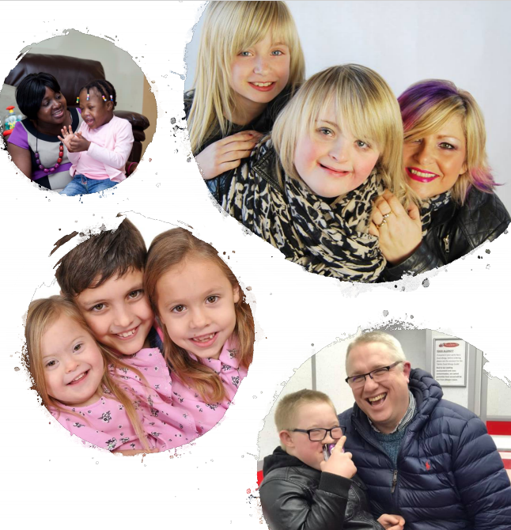
Children with Down syndrome share some physical characteristics...
but look more like their families than each other.

Slide 17
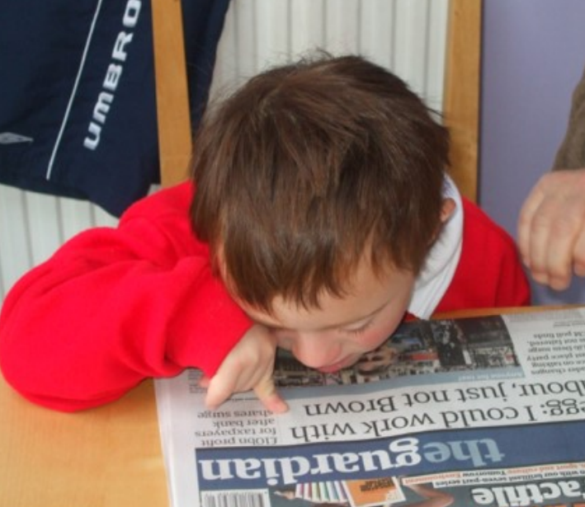
It may take children with Down syndrome longer to learn some things.

Slide 18
Let’s try to remember what Ella can do, that you can do too…

Slide 19
Ella can…
• Help set the table
• Run, jump and climb
• Dance
• Help her sister get a drink
• Ride a bike
• Count to 10
• Laugh and share
• Learn and play

Slide 20
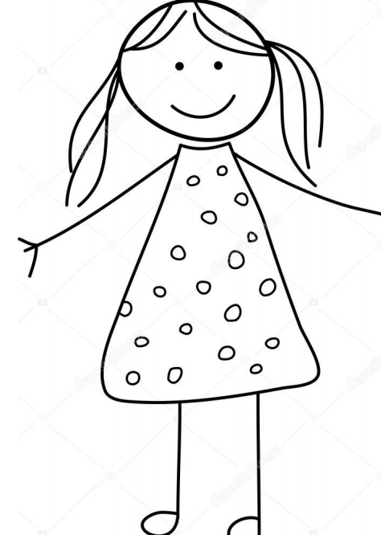
Activities
Ella and other children with Down syndrome can find handwriting tricky.
Can you copy the picture with your non writing hand and wearing a sock on it?!

Slide 21
Ella has a hard time saying some words.
She has to practise some words just like she has to practise sitting still.
We are going to try to say some words with our thumbs in our mouths!

Slide 22
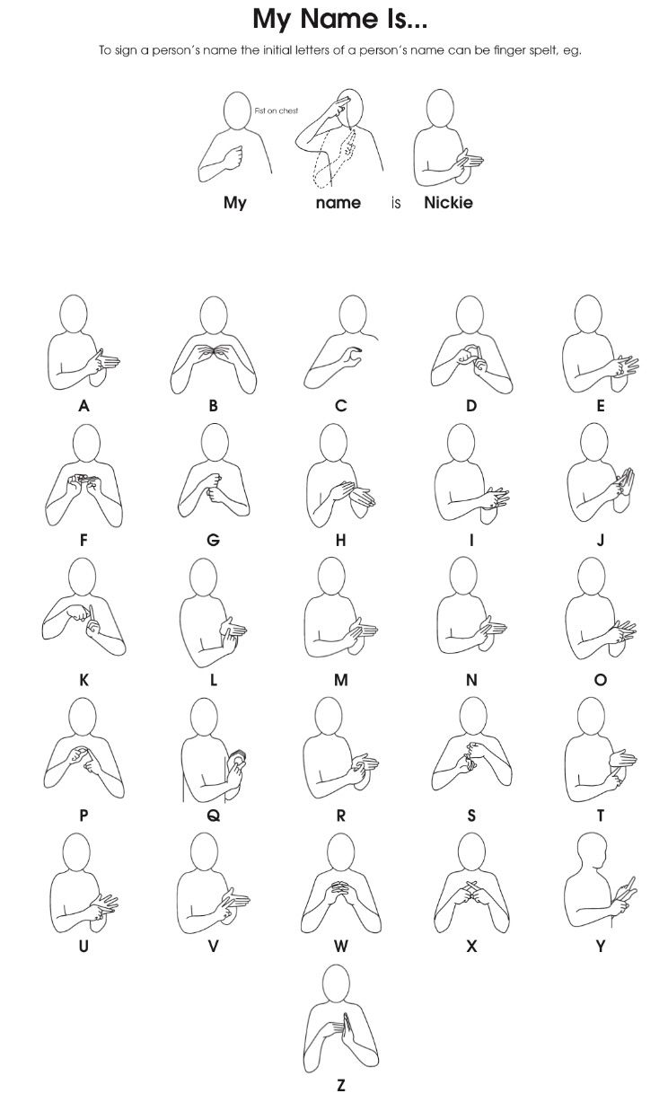
Ella finds it hard to say some words.
Children with Down syndrome have a lot to say but can’t always communicate easily.
When they are in KS1, children with Down syndrome may use actions alongside words to help them communicate.
This is called Makaton.
Can you sign your name?

Slide 23
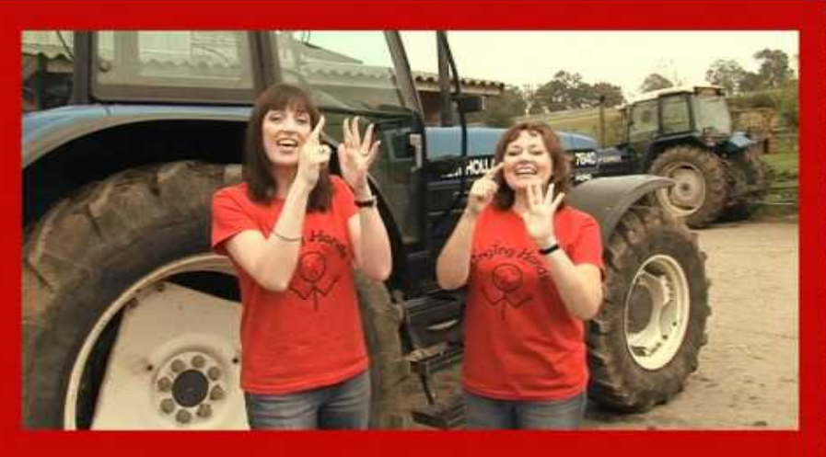
Join in with Old Macdonald using singing and signing
Singing Hands: Old MacDonald had a Farm - Makaton Sign Language - YouTube

Slide 24
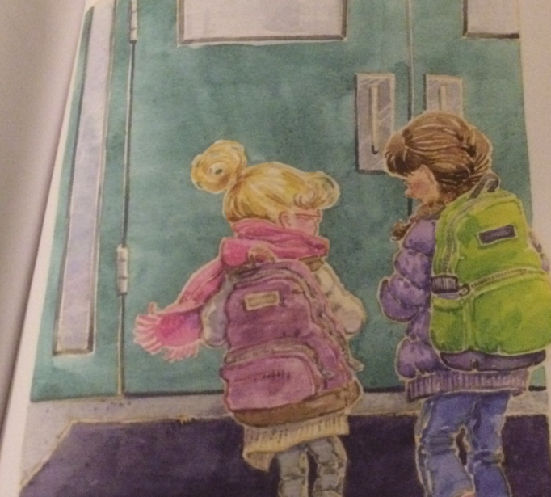
What else can we remember about Ella?

Slide 25
What does Ella love most?
To be with her friends.
Just like you…

Slide 26
© 2021 Positive about Down Syndrome | A DSUK initiative
All rights reserved | Registered Charity Number 1184564

